Slide 1


















PRESENTATION BY KULBHUSHAN JAIN VEENA JAIN TRUST
FOR EXTENSION ON EMPANELMENT WITH PSDM

Slide 2









KJVJT FOUNDED 2009
NSDC AUTHORIZED TRAINING PARTNER
IMPLEMENTION PLAN AFTER TARGET ALLOCATION
MONITORING PLAN FOR PROJECT EFFICIENCY
EXISTING TRACKING PROCESS POST
PLACEMENT OF ALUMNI
EMPLOYABILITY POTENTIAL ASSESSMENT BASED ON TARGET DEMAND AND MOU’S SHARED

Slide 3


ABOUT US
Kulbhushan Jain Veena Jain's Trust was established in 2009 with aim To produce excellent Medical professionals with strong academic base and sound technical competence who can effectively serve the community.
KJVJT is approved and affiliated with Indian Nursing Council, New Delhi, Punjab Nurses Registration Council, Chandigarh & Govt. of Punjab and are running one nursing college and one management college and have trained more 4000 candidates so far. KJVJT has recently nominated as approved Non funded NSDC training partner.
The Kulbhushan Jain Veena Jain Trust Established “Mother Mary’s Institute of Nursing” at Nasrala in the year 2010-11 with ANM,Post Basic B.Sc Nursing & in the year 2011-12 started GNM & B.Sc Nursing after approval & affiliation from Indian Nursing Council, New Delhi, Punjab Nurses Registration Council, Chandigarh & Govt. of Punjab. Since then the result of the students are self spoken & enough to prove the seriousness of the Trust towards its aims & objectives. Presently the Trust has 300 satisfied students and their families
KJVJT’S ASSOCIATIONS
Indian Nursing Council, New Delhi,
Punjab Nurses Registration Council
NSDC
PSDM
NRLM

Slide 4

ABOUT US
Social Activities:
100 bedded with modern facility Charitable Hospital is being run by the Trust for Welfare of the needy & poor Peoples
of the area.
The regular free medicals check-up camps is the regular program of the Trust. The Trust not only provided free medical check-up for Dental, General, Gynecology, Eye & Heart diseases but free medicines are also being distributed to the needy patients of the rural & urban area
Infrastructural & Other Facilities: The Institute will have all modern Medical & Associated equipments & Best Infrastructure and other facilities.
Hospital: The 2 story ultra modern Hospital, equipped with state of art medical equipments & facilities, will have occupancy strength of 100 beds. The Hospital has different departments for each specialization like Medical, Surgical, Gyne & Obs, Pediatric, Psychiatric, Dental, E.N.T, recovery, immunization, O.T, Laboratory, Emergency etc.
Bus Service for Staff & Students: The Trust is already having 3 transport vehicles for the staff & students and more vehicles may be added as & when required.
Generator Set: The Institute is already having Silent Gen set to assure 24 hrs power supplies.

Slide 5

ABOUT US
Well Stocked Library: The well furnished computerized Library is full of books of National & International Authors. The reputed national & International Journals, E-Journals, Magazines and Newspapers are subscribed. The Library already attached with the E- Library facilities of Baba Farid University of Health Sciences, Faridkot & also connected with internet connection for the use of staff & students.
Safety: The Trust has all modern safety gadgets to make the Institute safe from all type of hazards i.e. electric, fire etc. The Institute has well trained professional (Male & Female) security staff.
Audio Visual Enabled Lecture Hall/Class Rooms & Conference Hall: All the Lecture Halls/Class Rooms are equipped with all modern audio video gadgets for smooth delivery of the lecture & create a very good ambience for better professional learning. The fully air-conditioned meeting/conference hall is also available.
Highly Educated Professional & Experienced Faculty & Staff: The Institute will recruit Highly Educated,
professional & experienced faculty & staff as per the rules & regulations framed by the affiliating body.
Computerized Internet Linked Office: The administrative offices are fully computerized & linked to internet through word class fully interactive website. The students & their parents have facility to get online facilities regarding submission of admission forms, admission fee and academic records from any computer worldwide through their personalized password protected accounts. This will provide them hassle free environment to motivate them for better study.

Slide 6
ABOUT US
Ambulance: The Trust is committed to add one more ambulance as & when required.
Socio Economic Benefits: However our Institute provide direct employment to approximately 80-90 person of the nearby areas & Professionals from all over India, the Institute will also provide indirect benefits to the hundreds of people, it will provide health facilities to the hundreds of needy people of rural area, which is also the prime target of the government. Thus the state but it will also prove be a major helping hand to the Government for attainment of mission of disease free HEALTHY SOCIETY.
Viability of Project: The Nursing profession is a widely accepted & successful system and more & more peoples are attracted to this system day by day. Due to growing demand, the takers of Nursing profession in academic are also increasing day by day & this is growing to be the need of the hour. Our Institute provides vast Nursing profession training to the students. Keeping in view the continuously growing demand of Nursing profession, this project is highly viable.

Slide 7
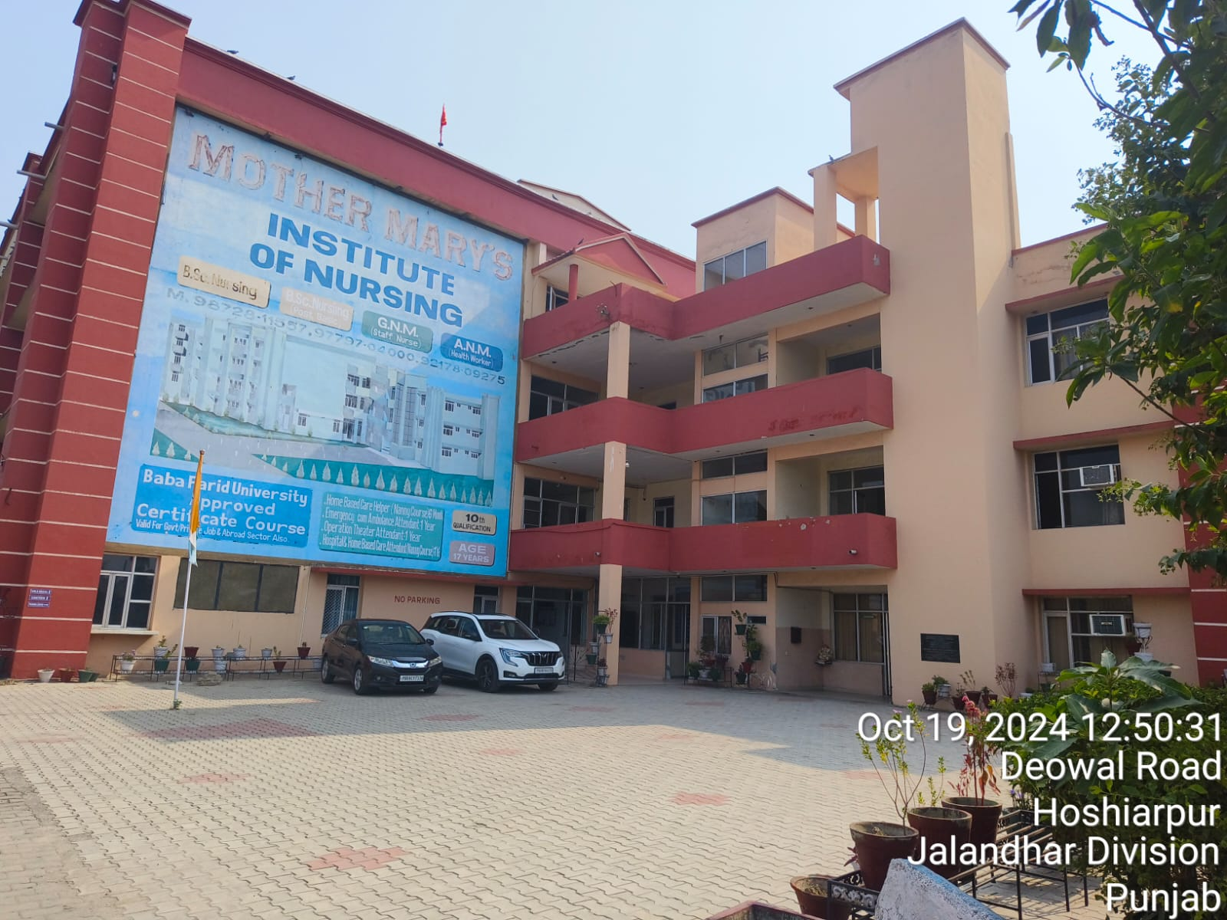
INFRA-PHOTOS

Slide 8

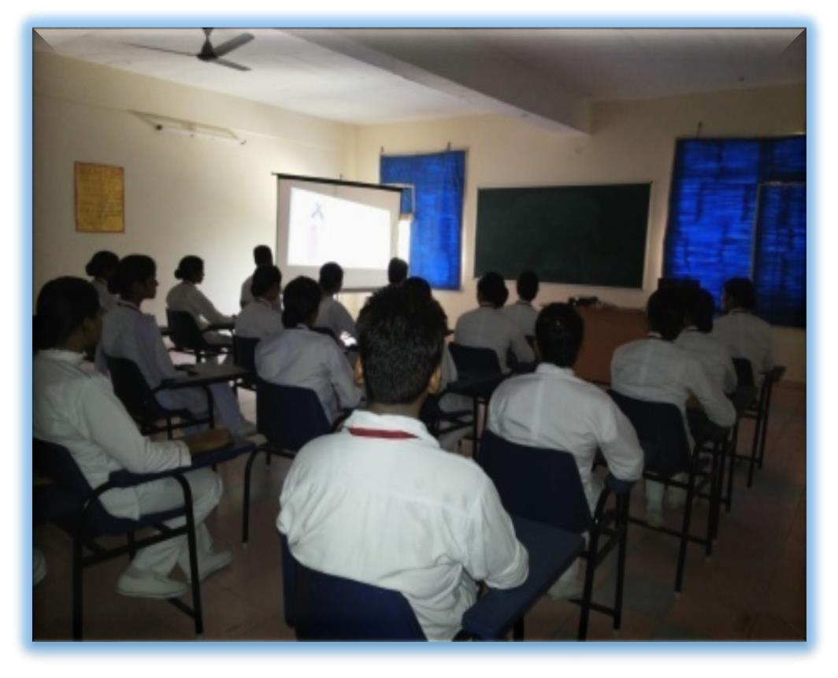
INFRA-PHOTOS

Slide 9

IMPLEMENTION PLAN AFTER TARGET ALLOCATION
Define Clear Objectives:
Clearly articulate the goals and objectives of the skill development training program. Align objectives with the overall organizational strategy and individual career growth.
Identify Target Audience:
Define the specific target audience for the training program. Consider factors such as job roles, skill levels, and departments

Slide 10



















1
MOBILIZATION
2
COUNSELING
3
IMPLEMENTION PLAN AFTER TARGET ALLOCATION
MOBILIZATION
4
ASSESSMENT
5
ASSESSMENT
6
POST PLACEMENT TRACKING

Slide 11
METHODOLOGIES –MOBILIZATION TEAM
An Internal Team comprises of Placement executive, Mobiliser and Teacher / Counselor.
local Govt. authorities will add values to group.
Involvement of LOCAL TEACHERS/ CELEBRITIES / MOTIVATORS / ACADEMICIAN / SOCIAL WORKERS.
Specific Dress Code for Internal Team for Mobilization
Team Equip with all Publicizing Materials and Information Sheet on Project and its Objectives.
Preparation of Plan Sheet on Visits, Publicizing timings and Schedule. Weekly / Monthly.
Ops Head / Leader among have regular discussion before and after execution. Motivating team leaders and whole team for whether we are motivated to serve or still need to get motivated

Slide 12

METHODOLOGIES –MOBILIZATION & COUNSELING
Post Identification of candidates
Make a Group of minimum 8 to 10 upto 35 aspirants.
Make a Group of minimum 8 to 10 upto 35 aspirants' parents
In case of Group; comprises of Aspirants + Parents; also it should not be more than 70..
Fix a date and place or address instant group. HAVE A SESSION-I
Greet them with passion and affectionately.
Server them at least a cup of team or chocolate.
Register them
Use achievable and relevant materials
Understand the expectations for your aspirants.
Help students set achievable goals for themselves
Be caring and supportive
Avoid negative feedback
Call them to visit training institute
Conduct aptitude tests
Conduct one by one counseling for both parents and candidates
Show motivational videos of previous trainings and placements.
Assign job roles as per capability of candidate

Slide 13
Allocate Resources:
Determine the budget, time, and human resources required for the training. Allocate trainers, training materials, and technology tools.
Curriculum Development:
Design a comprehensive curriculum that aligns with the identified skills and objectives. Break down the curriculum into modules or sessions.
Select Training Methods:
Choose appropriate training methods based on the nature of the skills to be developed. Consider a mix of classroom training, online courses, workshops, and hands-on experiences.
Create a Training Schedule:
Develop a detailed training schedule, including dates, times, and locations. Ensure flexibility to accommodate different learning styles and preferences.

Slide 14

Communication and Marketing:
Develop a communication plan to inform participants about the training program. Highlight the benefits and relevance of the training to encourage participation.
Pre-Assessment:
Conduct a pre-assessment to gauge the current skill levels of participants. Tailor the training content based on the assessment results.
Training Delivery:
Implement the training program according to the established schedule.
Monitor sessions to ensure they align with the curriculum and meet the participants' needs.
Feedback Mechanism:
Establish a feedback mechanism for participants to provide input during and after the training. Use feedback to make real-time adjustments and improvements to the training program

Slide 15

Post-Assessment:
Conduct a post-assessment to measure the effectiveness of the training. Compare results with the pre-assessment to evaluate skill development.
Recognition and Certification:
Recognize and reward participants who successfully complete the training. Provide certifications or badges to acknowledge their newly acquired skills.
Continuous Improvement:
Gather insights from the training program to identify areas of improvement. Use feedback to enhance future iterations of the skill development program.
Monitoring and Evaluation:
Implement a system for ongoing monitoring and evaluation of the training program's impact on participants' performance.
Analyze data and adjust the program as needed to ensure long-term success.

Slide 16

Documentation and Reporting:
Maintain detailed documentation of the entire training process, including attendance records, assessment results, and feedback.
Generate reports to assess the overall effectiveness of the skill development program.

Slide 17

MONITORING PLAN FOR PROJECT EFFICIENCY
Objective and Goals:
Clearly outline the overall objectives and specific goals of the skill development training project.
Key Performance Indicators (KPIs):
Identify and define measurable KPIs that align with the project's objectives. Examples include:
Completion rates of training programs.
Improvement in participants' skills and competencies.
Job placement rates for participants.
Participant satisfaction with the training.
Data Collection:
Specify the sources of data for each KPI.
Participant assessments.
Pre and post-training evaluations.
Feedback from trainers and trainees.
Job placement records.

Slide 18















PROJECT MONITORING PLAN
Design of Detailed Curriculum and sign off from the client
Suggest formal sign off and trainers to be used for the Training
Organize and get formal sign off on trainers to be used for the training
Periodic Assessments of Students to check understanding & report Results to client
Training Delivery by Qualified and signed-off Trainers.
Design of assessments and other learning aids for the program
Ensure High Level of Engagement with field Visits or Visits by Client designated Contacts
Goal: Students Should be able to Clear any entrance or mandatory Exam Defined
Ensure 100% Student Attendance During Training
GUEST LECTURES/ INDUSTRIAL VISITS

Slide 19








TRAINING PROCESS
Project Head
Project Manager
MIS
Executive
Chairman
Tools for used effective monitoring process:
Centralized CCTV monitoring online access to top management
HRMS for employees
Weekly and monthly review meetings and sessions with staff and trainees
Monthly meeting sessions with parents
Weekly and Monthly tracking report of each trainee and trainers
Weekly assessments
Actively meeting sessions with PSDM for inputs and feedback
Weekly training feedback from candidates
Placements tracking sessions with employers and candidates during placement process for feedback.
Trainers
Counselors
Mobilizers

Slide 20
Data Analysis:
Define the frequency and methods of data analysis.
Regular reviews of participant progress.
Quarterly or monthly analysis of KPIs.
Comparison of pre and post-training assessments.
Reporting:
Determine the format and frequency of reporting.
Monthly progress reports.
Quarterly performance summaries.
Annual project reviews.
Stakeholder Communication:
Outline a communication plan for sharing results with stakeholders.
Regular updates to project sponsors and funders.
Sharing success stories and testimonials.
Addressing challenges and proposed solutions.

Slide 21
Quality Assurance:
Establish mechanisms for ensuring the quality of training.
Regular audits of training materials and methods.
Peer reviews for trainers.
Continuous improvement based on feedback.
Risk Management:
Identify potential risks to the project's efficacy and develop mitigation strategies.
Staff turnover.
Changes in industry requirements.
Technological disruptions.
Budget Monitoring:
Include a budgetary component to ensure financial resources are allocated effectively.
Regular reviews of budget vs. actual expenses.
Adjustments based on evolving needs

Slide 22
Timeline Adherence:
Monitor project timelines to ensure timely completion of training programs.
Regular checkpoints for each phase of the project.
Adjustments to timelines if necessary.
Continuous Improvement:
Establish a process for incorporating lessons learned into future training programs.
Post-implementation reviews.
Feedback sessions with trainers and participants.
Incorporating industry best practices.
Evaluation and Review:
Plan for formal evaluations at key milestones to assess overall project efficacy.
External evaluations, if applicable.
Internal project reviews

Slide 23
Legal and Ethical Compliance:
Ensure that all aspects of the project adhere to legal and ethical standards.
Compliance with data protection regulations. Adherence to fair employment practices.
Sustainability Plan:
Develop strategies for sustaining the impact of the skill development training beyond the project timeline.
Alumni networks and ongoing support.
Integration of training into existing education systems.
Adaptation to Change:
Create a framework for adapting the monitoring plan in response to unforeseen changes or challenges.
Flexible monitoring tools and methodologies. Regular risk assessment

Slide 24


EXISTING TRACKING PROCESS POST PLACEMENT OF ALUMNI
Existing Tracking Process
Post-placement tracking in a skill development scheme refers to the process of monitoring and assessing the progress and success of individuals after they have been placed in employment. This aspect of tracking is crucial for evaluating the effectiveness of the skill development program and ensuring the sustained well-being and progress of the individuals in their chosen careers. Here are some key components of existing post-placement tracking:
Job Performance Monitoring: This involves evaluating how well individuals are performing in their jobs after completing the skill development program. Employers may provide feedback on the skills, competencies, and work ethics of the individuals.
Retention Rates: Post-placement tracking assesses how long individuals stay employed in their initial job placements. High retention rates indicate that the individuals are well-suited for their roles and are likely satisfied with their employment.

Slide 25





EXISTING TRACKING PROCESS POST PLACEMENT OF ALUMNI
1ST MONTH
2ND MONTH
3RD MONTH
Discuss candidate motivate understand
regarding retention and
Taking feedback from employer regarding candidates performance and taking job satisfaction from candidates and salary received .
Collect documents from employer as required
Ensure job satisfaction of
candidate to
candidate and motivate
employability
them regarding retention at
benefits and importance
their work place. Meet
of today’s
job Inform regarding
candidate's parents to
competition. employer
motivate them regarding the importance of this job for them as well as their child
documents to be required
Note :Process continues for 1 year and help candidate in job change if needed and PPS to be released every month of applicable

Slide 26
Career Advancement:
Tracking includes monitoring whether individuals are able to advance in their careers over time. This could involve promotions, salary increases, or moving into higher-skilled positions within the same industry.
Further Education and Training:
Some individuals may choose to pursue further education or training to enhance their skills or specialize in a specific area. Post-placement tracking may include monitoring whether individuals engage in lifelong learning opportunities.
Income Growth:
Assessing whether individuals experience growth in their income over time is an important aspect of post-placement tracking. It reflects the economic impact of the skill development program on individuals and their families.

Slide 27
Job Satisfaction:
Collecting feedback on job satisfaction from individuals can provide insights into the overall success of the skill development program. Satisfied individuals are more likely to remain engaged in their careers and contribute positively to their workplaces.
Support Services:
Tracking may also involve assessing whether individuals continue to receive support services or mentoring after placement. This support can be beneficial for addressing challenges that may arise in the early stages of employment.
Feedback and Continuous Improvement:
Post-placement tracking provides valuable data for program administrators to receive feedback on the effectiveness of the skill development initiatives. This information can be used to make improvements to the program and enhance its impact on future participants.

Slide 28
Overall, post-placement tracking aims to ensure that individuals not only secure employment but also experience sustained success and growth in their careers. This contributes to the long-term success of the skill development program and the economic empowerment of the individuals involved

Slide 29

EMPLOYABILITY POTENTIAL ASSESSMENT BASED ON TARGET DEMAND AND MOU’S SHARED
Assessing employability potential based on target demand and Memoranda of Understanding (MOUs) in a skill development training scheme involves evaluating the alignment between the skills being imparted through training programs and the actual demands of the job market. Here are the key steps involved in this process
Identifying Target Demand:
Occupational Analysis: Conduct a thorough analysis of the job market to identify in-demand occupations and industries. Consider factors such as economic trends, emerging sectors, and the specific needs of local or regional employers.
Skill Gap Analysis: Identify the skills that are currently in demand and compare them with the existing skills of the workforce. This helps in determining the gaps that need to be addressed through skill development programs.

Slide 30
Establishing Partnerships and MOUs:
Industry Collaboration: Collaborate with industries, businesses, and employers to understand their specific skill requirements. Establish partnerships with organizations willing to support and participate in the skill development initiative.
MOUs with Employers: Enter into MOUs with employers, industry associations, and relevant stakeholders. These agreements should outline the commitments and expectations of both parties, including the types of skills needed and the employment opportunities available.
Designing Training Programs:
Curriculum Development: Develop training programs that align with the identified target demand and the skills specified in MOUs. Ensure that the curriculum is dynamic and responsive to changes in the job market.
Industry-Relevant Content: Include practical, industry-relevant content in training programs. Consider incorporating real-world projects, case studies, and hands-on experiences to enhance the employability of participants

Slide 31

Monitoring and Evaluation:
Post-Training Assessment: After completing the training, assess participants' skills to determine the effectiveness of the program. This evaluation should consider the alignment of acquired skills with the targeted demand and the requirements outlined in MOUs.
Placement and Employment Tracking: Track the placement and employment outcomes of participants to assess the success of the program in meeting the demands of the job market.
Feedback Mechanism:
Employer Feedback: Establish a feedback mechanism with employers to gather insights into the performance of trained individuals in the workplace. Use this feedback to refine and enhance future training programs.
Participant Feedback: Seek feedback from participants regarding their experiences and the relevance of the training to their employment. This information can guide improvements in the program design and delivery.

Slide 32
Continuous Improvement:
Iterative Process:
Treat the employability assessment as an iterative process. Continuously analyze market trends, update training programs, and adapt to evolving industry needs to ensure sustained relevance and effectiveness.
By systematically assessing employability potential based on target demand and MOUs, a skill development training scheme can enhance its impact on participants' ability to secure and sustain employment in high-demand sectors

Slide 33






PLACEMENT TIE-UPS
Sr.No. | Company Name | Name of Employer | Designation | Email-ID | Location | Contect Number | SALARY | Required candidates
1 | Sahara Helping Hands Hoshiarpur | Amardeep Singh | Owner |  | Hoshiarpur | 9463444196 | 12000 | 100
2 | Vcare, Home Healthways India Pvt.Ltd. Mohali | Sandeep Sharma | Owner |  | Mohali | 9888584633 | 12000 | 150
3 | Life Time Home Care Ludhiana | Ajay Kumar | Owner |  | Ludhiana | 7889027985 | 11500 | 100
4 | Holly Cross Home Health Care Ltd. Mohali | Mr. Thomas | Owner |  | Mohali | 8264194413 | 11500 | 180
5 | Care Health Nurses Pvt. Ltd. Delhi | Poornima | Placement Coordinator |  | Delhi | 6283384940 | 12000 | 150
6 | J-Rafa Health Care Pvt. Ltd. Ludhiana | Joy Paul | Owner |  | Ludhiana | 9646683481 | 12000 | 100
7 | Shivay Nursing Healthcare Pvt. Ltd. Mohali | Mr. Shivang | HR |  | Mohali | 9999407473 | 12000 | 180
8 | MedyHealth Tecnologies Pvt. Ltd. Mohali | Samrita | Owner |  | Mohali | 7347003774 | 13000 | 200
9 | Live Well Smart Care Hoshiarpur | Seema | Owner |  | Hoshiarpur | 8728825700 | 11500 | 250
10 | Wellbeing Home Care Pvt. Ltd. Gurugram | Jitender Sharma | Owner |  | Gurugram | 9899304466 | 18000 | 150

Slide 34





SANJEEV CHOPRA (DIRECTOR_KJVJT) MOBILE NO: 92177-86346
E-MAIL ID : SANJEEV_720@GMAIL.COM
33,GURJAIPAL NAGAR,DISTRICT-JALLANDHAR-144001 (PUNJAB)

